Slide 1
2025 Autmun
Intro-to-Machine Learning
Homework 3
Release Date: 2025/11/04 15:30
Notes:
‹#›

Slide 2
Homework 3
Deadline: 23:59, Nov. 18th (Tue), 2025
Coding (60%): Implement ensemble methods with Numpy and PyTorch.
Submit your code in executable python files (.py).
Report the outcome and parameters by screenshots to the questions.
Handwritten Questions (40%): Answer questions about ensemble methods.
Answer the questions in the report.
You must use the template and in digital-typed (no handwritten scan)
In English

Slide 3
Links
Questions and Report template
Sample code / Dataset
Notes:
Here are some links about this assignment, and these links are on E3 system too.

Slide 4
Coding Environment
Recommnedation: Python 3.9 or higher
Tips
We recommend you to use virtual environments when implementing your homework assignments.
Here are some popular virtual environment management tools
uv
Poetry
Conda
Virtualenv

Slide 5
Numpy & PyTorch
Numpy Tutorial: Link
PyTorch Tutorial: Link
Allowed to use any optimizer
Not allowed to used built-in loss function (Please implement it by your self!)

Slide 6
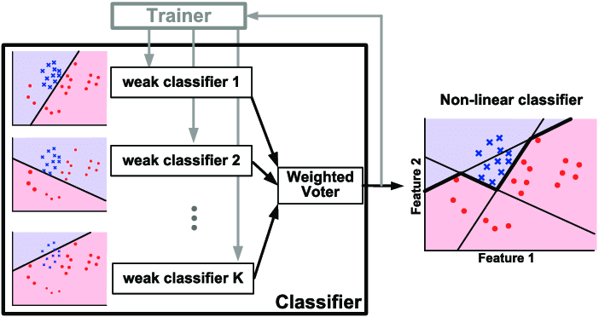
Adaboost
AdaBoost is a boosting technique in machine learning. It is called Adaptive Boosting as the weights are re-assigned to each instance, with higher weights assigned to incorrectly classified instances.
https://www.researchgate.net/figure/Illustration-of-AdaBoost-algorithm-for-creating-a-strong-classifier-based-on-multiple_fig9_288699540
Notes:
The second part is Adaboost.
In the course, you learned about AdaBoost, a boosting technique that leverages multiple weak classifiers. It is called Adaptive Boosting as the weights are re-assigned to each instance, with higher weights assigned to incorrectly classified instances.

Slide 7
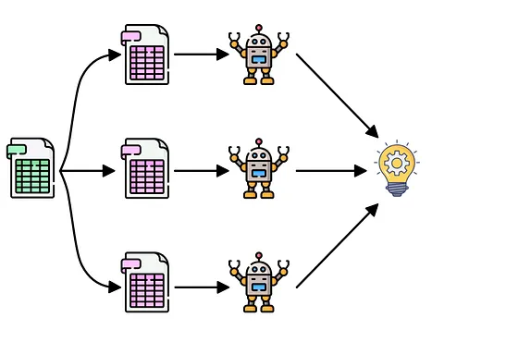
Bagging
Train multiple classifiers, each with a proportion of data.
Data is sampled from the whole training set with a sampling with replacement strategy.
Majority votes for the final prediction
image credit: Fernando López

Slide 8
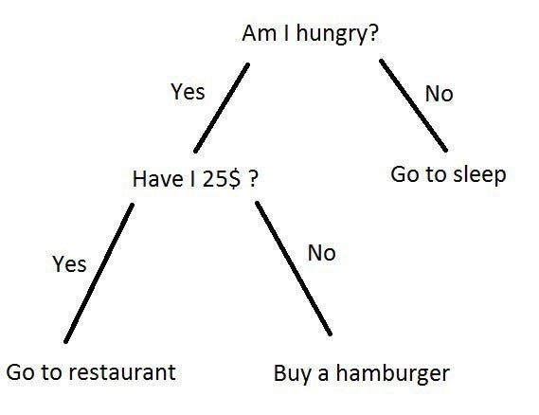
Decision Tree
Decision tree is a non-parametric supervised learning algorithm which has a hierarchical, tree structure, which consists of a root node, branches, internal nodes and leaf nodes.
image credit: Rishabh Mall
Notes:
The first part is about Decision Tree
In the course, you learned about Decision Tree, which is a non-parametric supervised learning algorithm which has a hierarchical, tree structure, which consists of a root node, branches, internal nodes and leaf nodes. At each internal node, a feature is selected, and one of its values is chosen to split the node, aiming to maximize information gain.

Slide 9
Dataset and Environment
Loan Dataset (Binary classification)
Already split into training and testing set
Features
You need to preprocess the dataset by yourself.
Normalization, encoding, etc.
Target
0 = Rejected
1 = Approved

Slide 10
AdaBoost (20%)
Accuracy | Score (pt)
>= 0.82 | 5
>= 0.78 | 3
>= 0.75 | 2
< 0.7 | 0
Requirements
Implement the AdaBoost method with weak linear classifiers
No non-linear activation function in intermediate layers (Only allowed for output layer)
Plot the AUC curve for each weak classifier
Plot the feature importance
Grading Criteria
(5%) Show your accuracy of the testing data with 10 estimators. (n_estimators=10)
(5%) Plot the AUC curves of each weak classifier.
(10%) Plot the feature importance of the AdaBoost method.
Also, paste the snapshot of your implementation of the feature importance estimation.
Explain how you compute the feature importance of the AdaBoost method shortly (< 100 words)
e.g, how to select, what is the key difference with Bagging

Slide 11
Bagging (20%)
Accuracy | Score (pt)
>= 0.82 | 5
>= 0.78 | 3
>= 0.75 | 2
< 0.7 | 0
Requirements
Implement the Bagging method with weak linear classifiers.
No non-linear activation function in intermediate layers (Only allowed for output layer)
Plot the AUC curve for each weak classifier
Plot the feature importance
Grading Criteria
(5%) Show your accuracy of the testing data with 10 estimators. (n_estimators=10)
(5%) Plot the AUC curves of each weak classifier.
(10%) Plot the feature importance of the Bagging method.
Also, paste the snapshot of your implementation of the feature importance estimation.
Explain how you compute the feature importance of the Bagging method shortly (< 100 words)
e.g, how to select, what is the key difference with AdaBoost

Slide 12
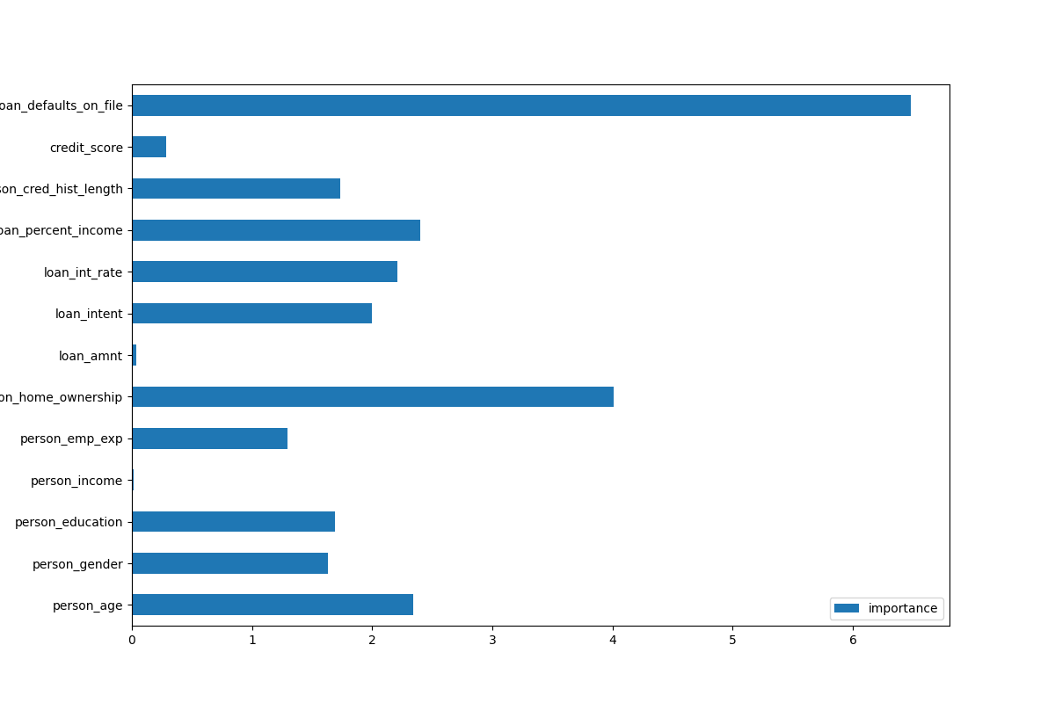
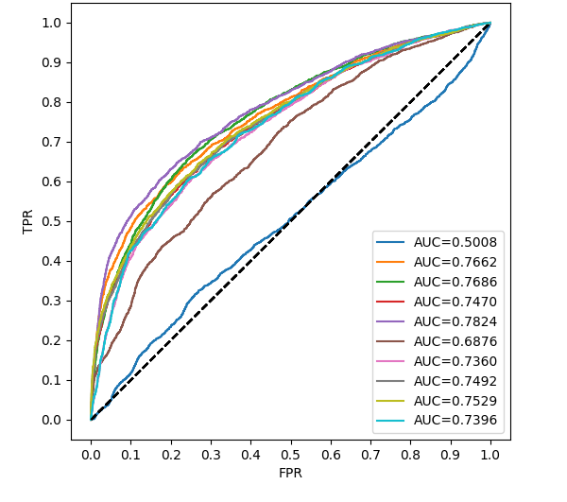
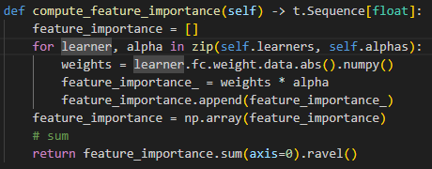
Plot examples
Examples of figures and code snippet. (Only for reference, not the answer)
Importance
Note: You can call sklearn to compute AUC

Slide 13
Decision Tree (15%)
Accuracy | Score (pt)
>= 0.90 | 5
>= 0.80 | 2
< 0.80 | 0
Requirements
Implement entropy for measuring the best split of the data.
Implement the decision tree classifier with the argument `max_depth`
Tips
Your model should produce the same results when rebuilt with the same arguments.
Grading Criteria
(5%) Compute the gini index and the entropy of the array [0, 1, 0, 1, 0, 0, 0, 1, 0, 1, 1].
(5%) Show your accuracy of the testing data with a max-depth = 7
(5%) Plot the feature importance of the decision tree. (No code snapshot for this question)

Slide 14

Additional Requirements (5%)
Python Coding Style Guide Reference
PEP8
Google Python Style
Code Check and Verification: Lint the code (5%)
Code linting:
-5pt per warning / error (any issue will make you get no point)
Paste the screenshot even there is no output for fully passed linting. (Prove you execute the code linting)
$ flake8 main.py
Example that shows warnings.

Slide 15

Handwritten Questions (40%)
2-1 (15%)
In the AdaBoost algorithm, each selected weak classifier h_t is assigned a weight
(a) What is the definition of ϵ_t in this formula?
(b) If a weak classifier h_t performs only as well as "random guessing" (i.e., ϵ_t = 0.5 ), what will α_t​ be?
(c) Based on your answer in (b), briefly explain how this α_t​ weight formula ensures the robustness of AdaBoost.

Slide 16
Handwritten Questions (40%)
2-2 (15%)
Random Forest is often considered an improvement over Bagging (Bootstrap Aggregating) when used with Decision Trees as the base learners.
(a) Briefly explain the potential problem that can exist among the T classifiers (C_1, ..., C_T) produced by Bagging when using decision trees.
(b) To mitigate the problem from (a), Random Forest introduces a second source of randomness in addition to Bagging. Specifically describe what this second source of randomness is and how it works.

Slide 17
Handwritten Questions (40%)
2-3 (10%)
Is it always possible to find a smallest decision tree that codes a dataset with no error in polynomial time? If not, what algorithm do we usually use to search a decision tree in reasonable time? Also, list the criterion that we stop splitting the decision tree and leaf nodes are created (List two).

Slide 18
Report
Please follow the report template format. (-5pts if not use the template)
Link
Notes:
About the report, please follow the report template format.

Slide 19
Submission
Compress your code and report into a .zip file and submit it to E3.
Report should be written in English. (-5 pts if not English)
<STUDENT ID>_HW3.zip
main.py
src/
setup.cfg
<STUDENT ID>_HW3.pdf (NO .doc, .docx or others format)
Don’t put the data (e.g. train.csv / test.csv) into submission file
Any format / submission issue: -5 pts (cumulative)
Notes:
About submission, you have to Compress your code and report into a .zip file and submit it on E3. You should name your files correctly.

Slide 20
Other rules
Late Policy: A penalty of 20 points per additional late day. (-20pt / delayed.day)
For example, If you get 90 points but delay for two days, your will get only 50 points!
No Plagiarism: You should complete the assignment by yourself. Students engaged in plagiarism will be penalized heavily. Super serious penalty.
e.g. -100pt for the assignment or failed this course, etc
Report to academic integrity office

Slide 21
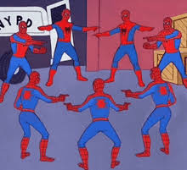
AI-Assistant
Not recommended but no forbidden
Copy-and-Paste answers from the AI-Assiant will be seen as Plagiarism
However, you can have your own answer first then rephrase it by AI-Assiant.
Some questions might be parts of final exam, make sure you understand the concept

Slide 22
FAQs
If you have other questions, ask on E3 forum first! We will reply as soon as possible.
Also, feel free to write email to TAs (And remember to cc all TAs).

Slide 23
Have Fun!

